Slide 1

Machine Learning Club
2020-2021 Info

Slide 2
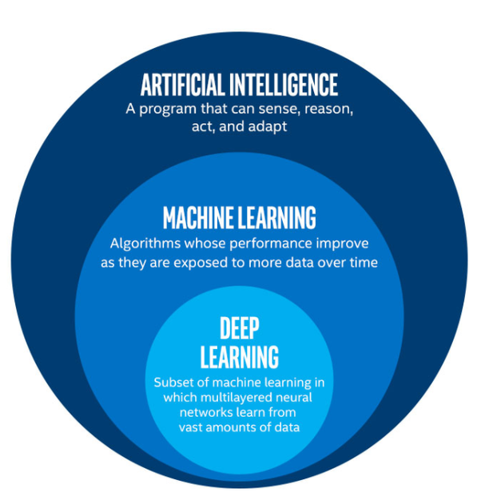
What is Machine Learning (ML)?
Machine learning involves building algorithms that can "learn" relationships in data
Once they are trained, they can be used to make predictions or decisions
These predictions happen without you explicitly programming it!

Slide 3
Why Learn About ML?
Wide applications across a variety of industries
Data science is a high paying job
The national average salary for a data scientist is $113,309
Improves analytical and coding skills
Machine learning involves analyzing & finding connections in data
Implementation of machine learning improves coding skills (particularly python skills)

Slide 4
About Machine Learning Club
We will guide you through everything you need to get started with machine learning
Some topics we will cover:
Python programming, basic calculus, and statistics
Regression and classification
Deep learning and neural networks
We will also do machine learning projects throughout the year

Slide 5
Logistics
Who can join?
We encourage everyone to join
HOWEVER, you will need to dedicate some of your own time to learning about Python, matrices, and the concept of a derivative if you do not know so already.
When are club meetings?
Tuesdays from 2:30pm to 3:30pm
Are there any club dues?
No, participation is 100% free

Slide 6

Demos
A3C
GPT-2
A few moments later, she heard the sound of a door opening behind her. "I'll be in the living room ." she called back, still walking in the opposite direction . She walked up to the living room window and looked out. It was still dark outside. She looked back and noticed something out of the corner of her eye.

Slide 7
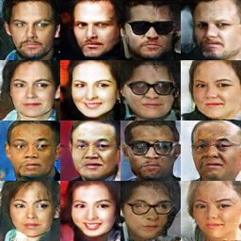
More Demos
DCGAN
Other AI sites
Colormind.io
moises.ai
Krisp.ai

Slide 8
More That ML Can Be Used For
Recommender Systems
Fraud Detection
Dimensionality reduction
Image Recognition
Time-Series Data processing
Auto Encoding
And a lot more..

Slide 9
Interested?
Click Join us on this site: https://wheelermlclub.github.io/wheeler-ml-club/index.html

